Slide 1
Face Detection
VJ method

Slide 2
Viola-Jones Face Detection Algorithm
Overview :
Viola Jones technique overview
Features
Integral Images
Feature Extraction
Weak Classifiers
Boosting and classifier evaluation
Cascade of boosted classifiers
Example Results

Slide 3
Viola Jones Technique Overview
Three major contributions/phases of the algorithm :
Feature extraction
Learning using boosting and decision stumps
Multi-scale detection algorithm
Feature extraction and feature evaluation.
Rectangular features are used, with a new image representation their calculation is very fast.
Classifier learning using a method called boosting
A combination of simple classifiers is very effective

Slide 4
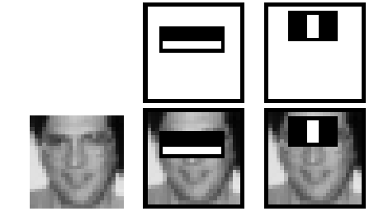
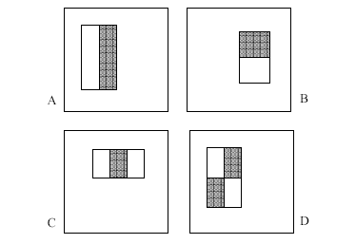
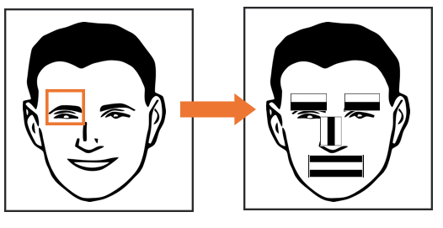
Features
Four basic types.
They are easy to calculate.
The white areas are subtracted from the black ones.
A special representation of the sample called the integral image makes feature extraction faster.

Slide 5
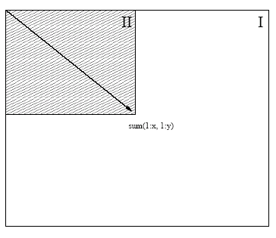
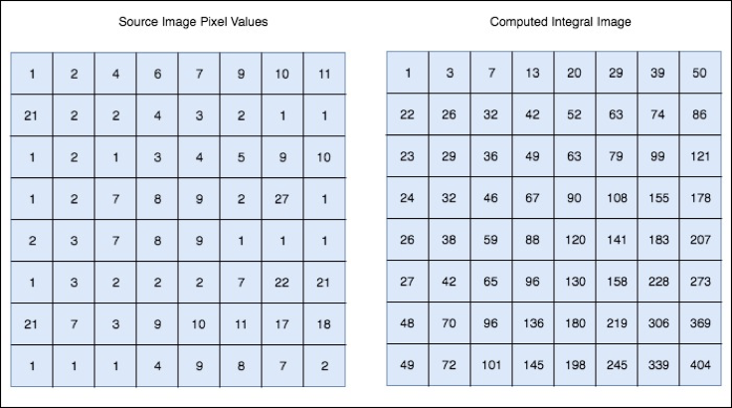
Integral images
Summed area tables
A representation that means any rectangle’s values can be calculated in four accesses of the integral image.

Slide 6
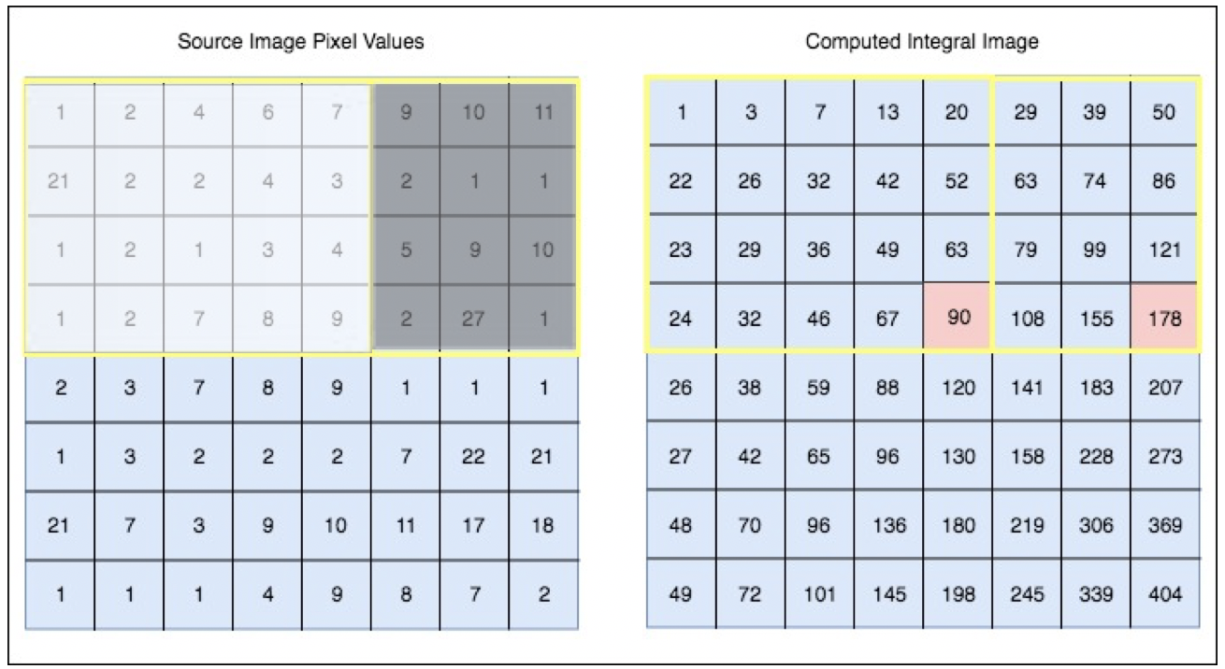
Fast Computation of Pixel Sums

Slide 7
Feature Extraction
Features are extracted from sub windows of a sample image.
The base size for a sub window is 24 by 24 pixels.
Each of the four feature types are scaled and shifted across all possible combinations
In a 24 pixel by 24 pixel sub window there are ~160,000 possible features to be calculated.

Slide 8
Learning with many features
We have 160,000 features – how can we learn a classifier with only a few hundred training examples without overfitting?
Idea:
Learn a single very simple classifier (a “weak classifier”)
Classify the data
Look at where it makes errors
Reweight the data so that the inputs where we made errors get higher weight in the learning process
Now learn a 2nd simple classifier on the weighted data
Combine the 1st and 2nd classifier and weight the data according to where they make errors
Learn a 3rd classifier on the weighted data
… and so on until we learn T simple classifiers
Final classifier is the combination of all T classifiers
This procedure is called “Boosting” – works very well in practice.

Slide 9
“Decision Stumps”
Decision stumps = decision tree with only a single root node
Certainly a very weak learner!
Say the attributes are real-valued
Decision stump algorithm looks at all possible thresholds for each attribute
Selects the one with the max information gain
Resulting classifier is a simple threshold on a single feature
Outputs a +1 if the attribute is above a certain threshold
Outputs a -1 if the attribute is below the threshold
Note: can restrict the search for to the n-1 “midpoint” locations between a sorted list of attribute values for each feature. So complexity is n log n per attribute.
Note this is exactly equivalent to learning a perceptron with a single intercept term (so we could also learn these stumps via gradient descent and mean squared error)

Slide 10
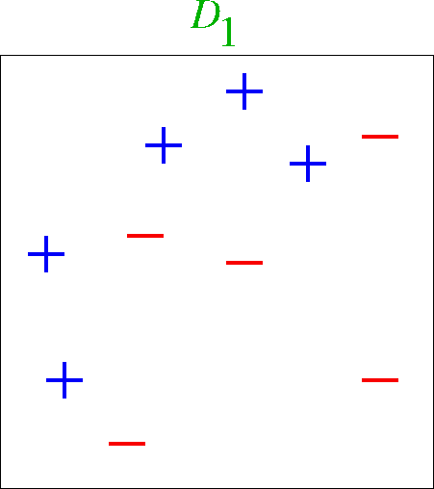
Boosting Example

Slide 11
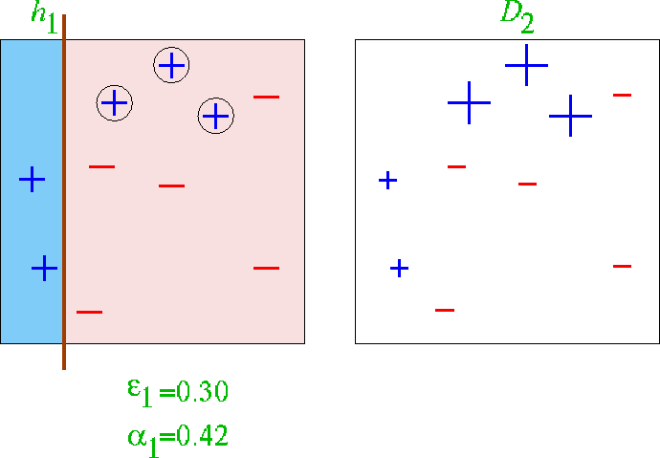
First classifier

Slide 12
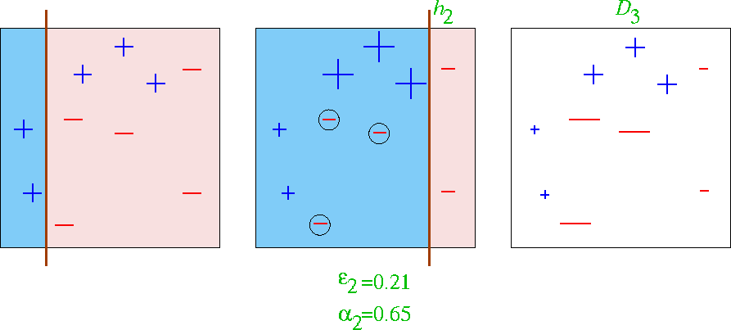
First 2 classifiers

Slide 13
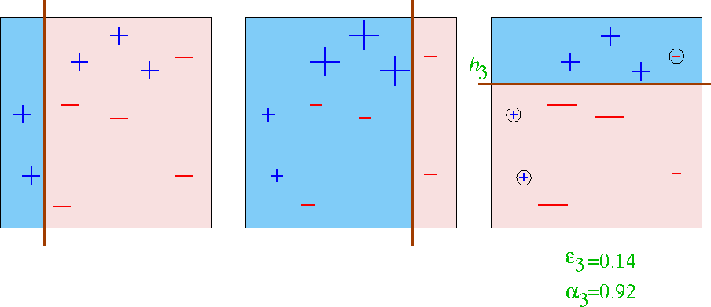
First 3 classifiers

Slide 14
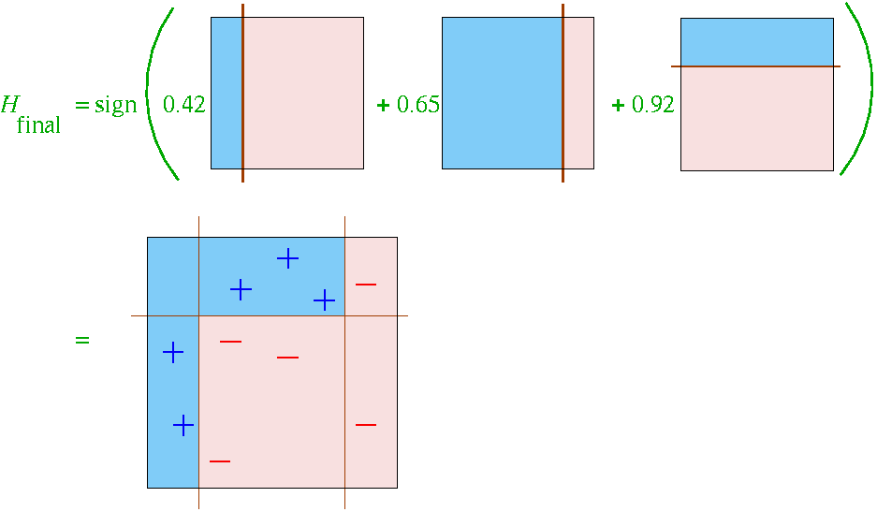
Final Classifier learned by Boosting

Slide 15
Final Classifier learned by Boosting

Slide 16
Boosting with Decision Stumps
Viola-Jones algorithm
With K attributes (e.g., K = 160,000) we have 160,000 different decision stumps to choose from
At each stage of boosting
given reweighted data from previous stage
Train all K (160,000) single-feature perceptrons
Select the single best classifier at this stage
Combine it with the other previously selected classifiers
Reweight the data
Learn all K classifiers again, select the best, combine, reweight
Repeat until you have T classifiers selected
Very computationally intensive
Learning K decision stumps T times
E.g., K = 160,000 and T = 1000

Slide 17
How is classifier combining done?
At each stage we select the best classifier on the current iteration and combine it with the set of classifiers learned so far
How are the classifiers combined?
Take the weight*feature for each classifier, sum these up, and compare to a threshold (very simple)
Boosting algorithm automatically provides the appropriate weight for each classifier and the threshold
This version of boosting is known as the AdaBoost algorithm
Some nice mathematical theory shows that it is in fact a very powerful machine learning technique

Slide 18
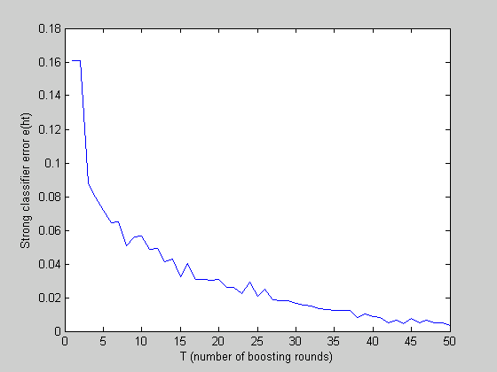
Reduction in Error as Boosting adds Classifiers

Slide 19

Useful Features Learned by Boosting

Slide 20
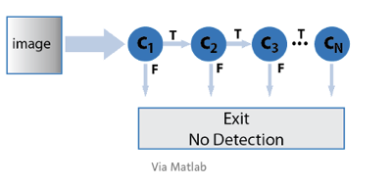
A Cascade of Classifiers

Slide 21
Detection in Real Images
Basic classifier operates on 24 x 24 subwindows
Scaling:
Scale the detector (rather than the images)
Features can easily be evaluated at any scale
Scale by factors of 1.25
Location:
Move detector around the image (e.g., 1 pixel increments)
Final Detections
A real face may result in multiple nearby detections
Postprocess detected subwindows to combine overlapping detections into a single detection

Slide 22
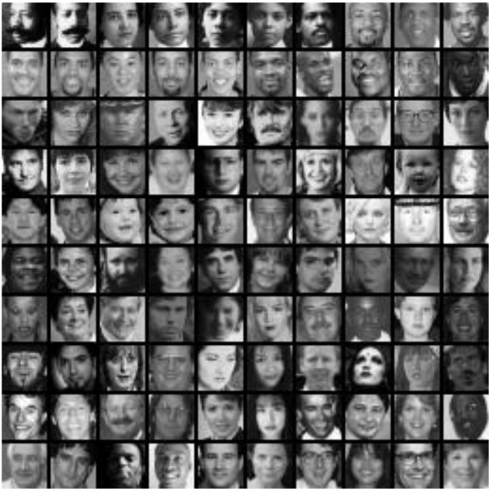
Training
Examples of 24x24 images with faces

Slide 23
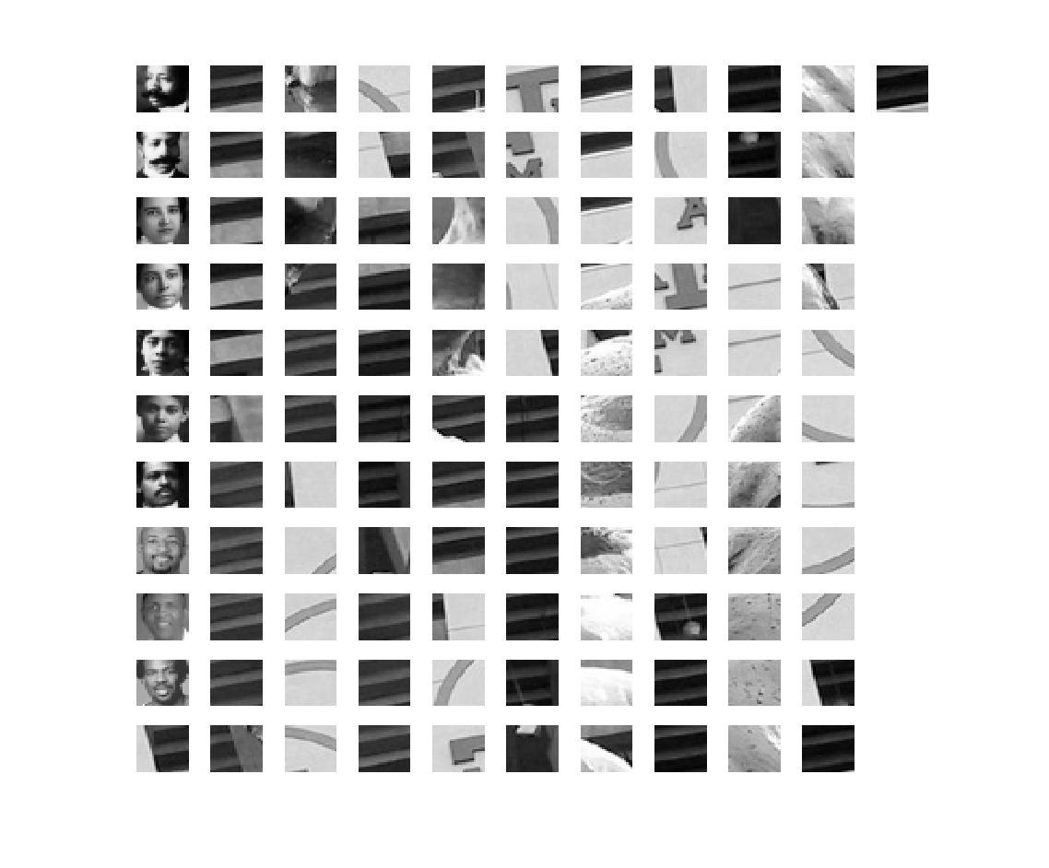
Small set of 111 Training Images

Slide 24
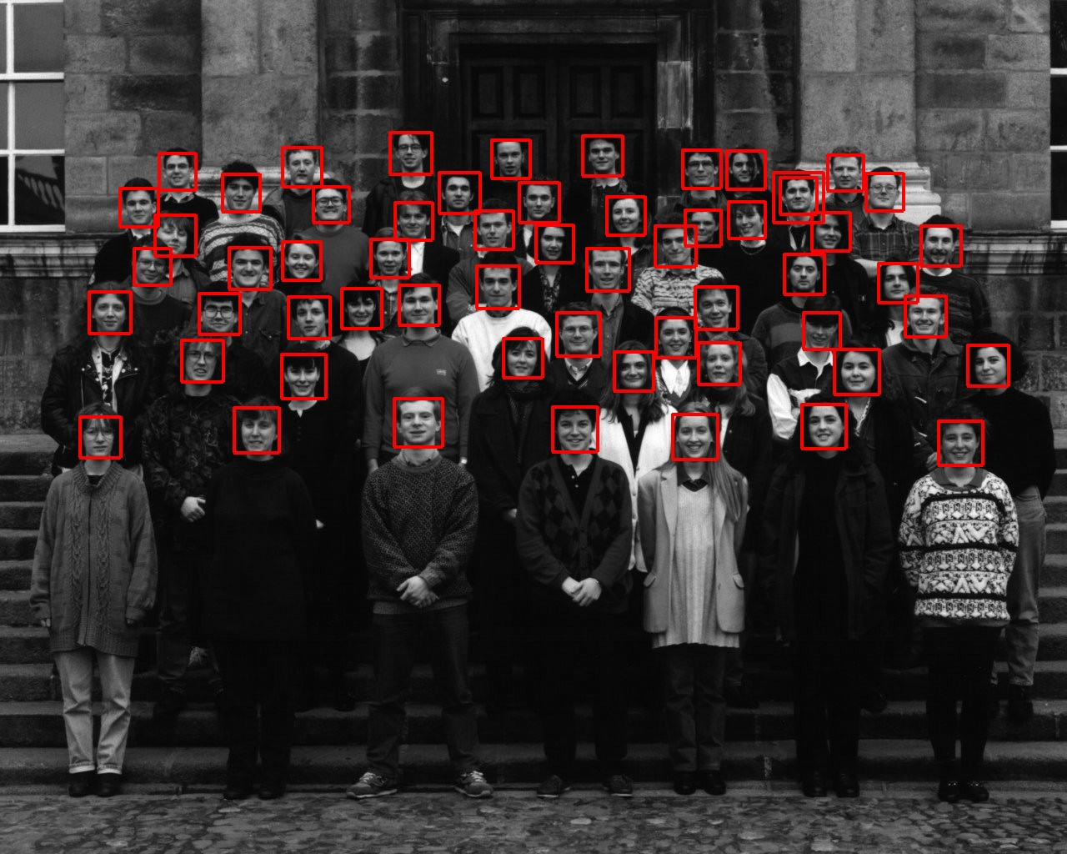
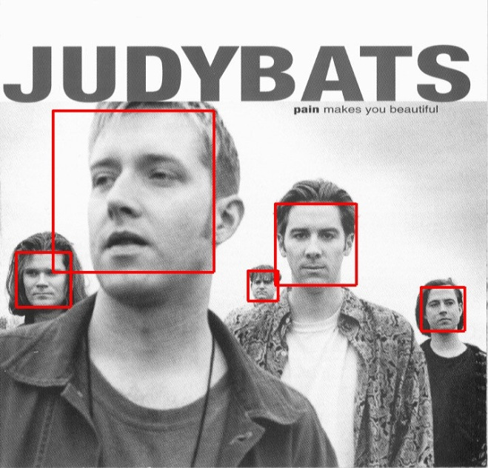
Sample results using the Viola-Jones Detector
Notice detection at multiple scales

Slide 25
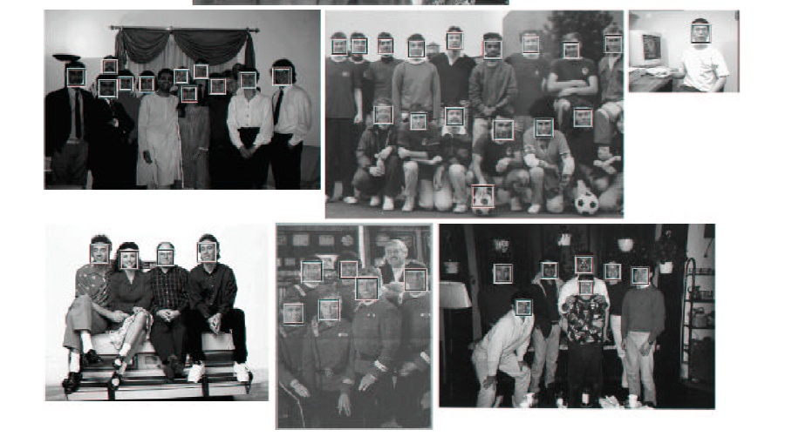
More Detection Examples

Slide 26
Histograms of Oriented Gradients for Human Detection
Another Descriptor

Slide 27
Overview
1. Compute gradients in the region to be described
2. Put them in bins according to orientation
3. Group the cells into large blocks
4. Normalize each block
5. Train classifiers to decide if these are parts of a human

Slide 28
Details
Gradients
[-1 0 1] and [-1 0 1]^{T} were good enough.
Cell Histograms
Each pixel within the cell casts a weighted vote for an
orientation-based histogram channel based on the values
found in the gradient computation. (9 channels worked)
Blocks
Group the cells together into larger blocks, either R-HOG
blocks (rectangular) or C-HOG blocks (circular).

Slide 29
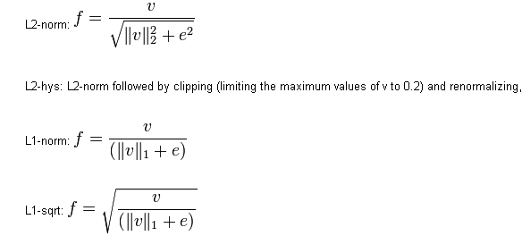
More Details
Block Normalization
They tried 4 different kinds of normalization.
Let υ be the block to be normalized and e be a small constant.

Slide 30
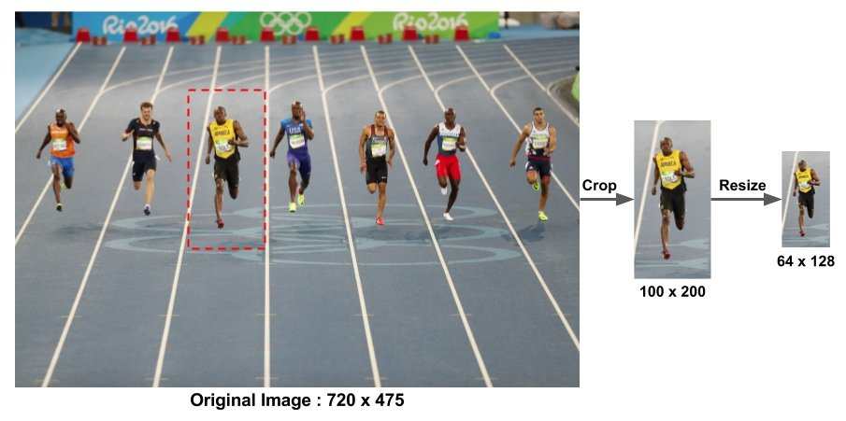
Pre processing

Slide 31
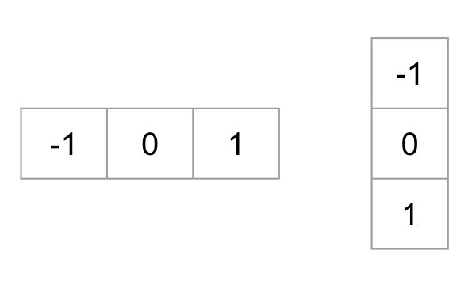
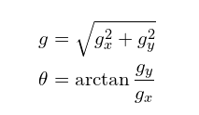
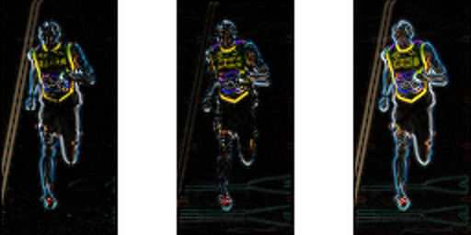
Gradient calculation

Slide 32
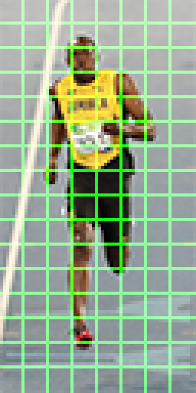
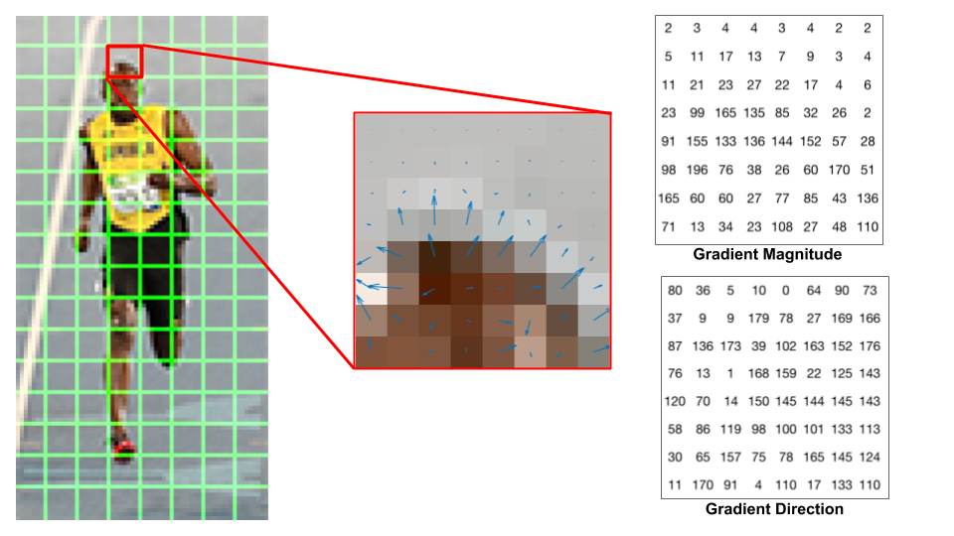
Histogram of gradients

Slide 33
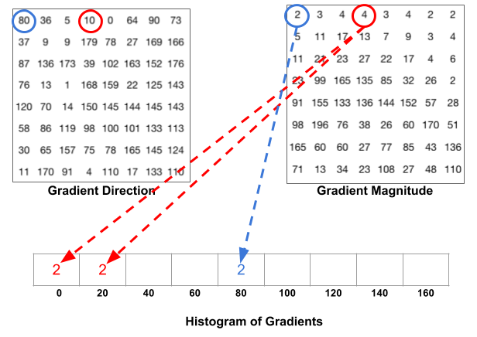
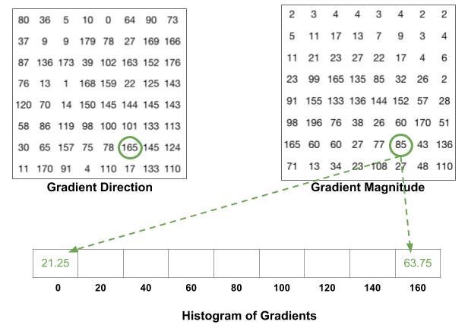
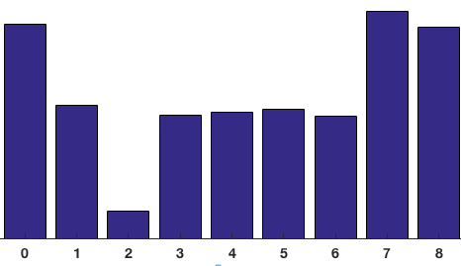

Slide 34
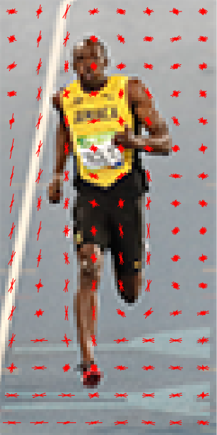
16x16 Normalization
→we have an RGB color vector [ 128, 64, 32 ]. The length of this vector is $\sqrt{128^2 + 64^2 + 32^2} = 146.64. This is also called the L2 norm of the vector. Dividing each element of this vector by 146.64 gives us a normalized vector [0.87, 0.43, 0.22].
→another vector in which the elements are twice the value of the first vector 2 x [ 128, 64, 32 ] = [ 256, 128, 64 ]. You can work it out yourself to see that normalizing [ 256, 128, 64 ] will result in [0.87, 0.43, 0.22], which is the same as the normalized version of the original RGB vector. You can see that normalizing a vector removes the scale.
→A 16×16 block has 4 histograms which can be concatenated to form a 36 x 1 element vector and it can be normalized just the way a 3×1 vector is normalized. The window is then moved by 8 pixels ( see animation ) and a normalized 36×1 vector is calculated over this window and the process is repeated.
How many positions of the 16×16 blocks do we have ? There are 7 horizontal and 15 vertical positions making a total of 7 x 15 = 105 positions.
Each 16×16 block is represented by a 36×1 vector. So when we concatenate them all into one gaint vector we obtain a 36×105 = 3780 dimensional vector.

Slide 35
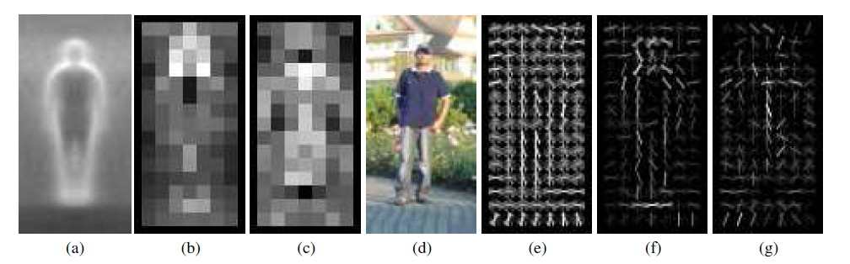
Pictorial Example
*
average gradient image over training examples
each “pixel” shows max positive SVM weight in the block centered on that pixel
same as (b) for negative SVM weights
test image
its R-HOG descriptor
R-HOG descriptor weighted by positive SVM weights
R-HOG descriptor weighted by negative SVM weights

